Slide 1
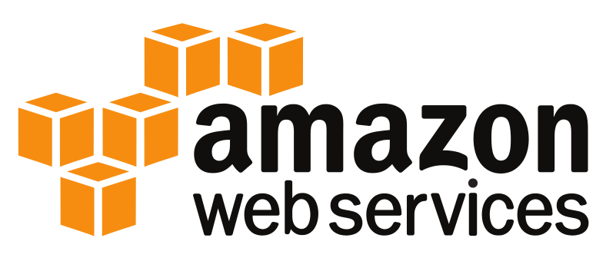
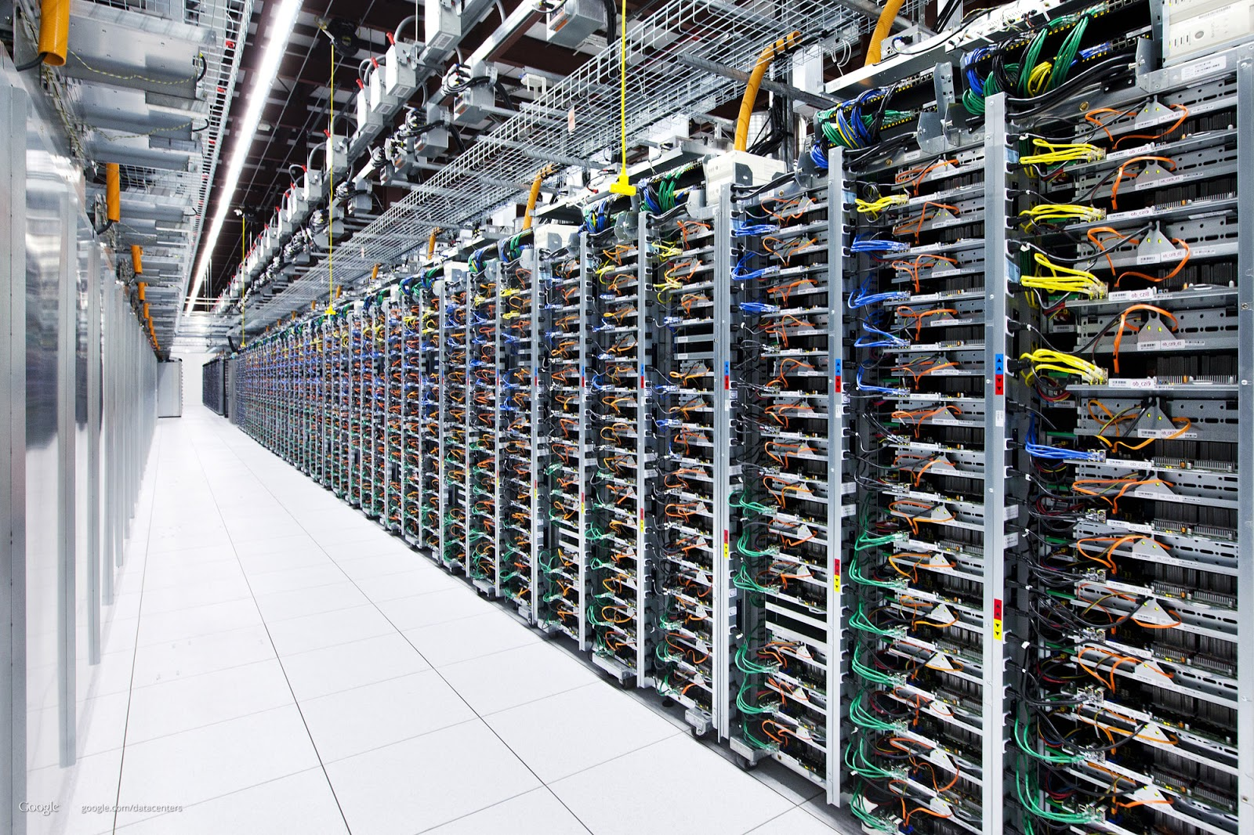
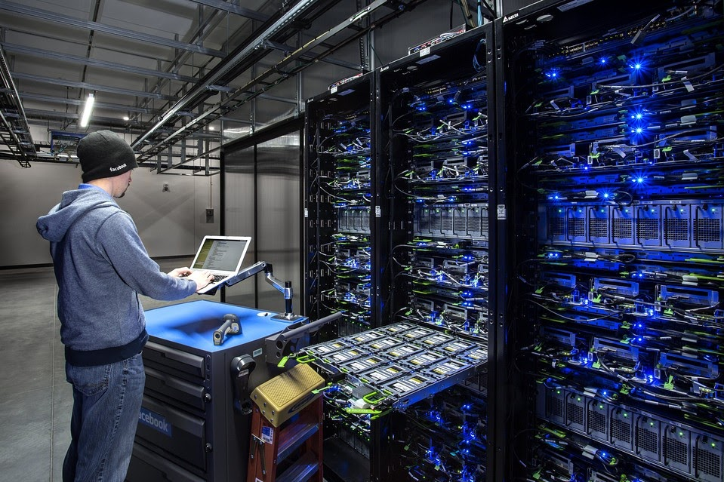
Introduction to Cloud Computing
Data Center Approach:
Requirement: Your company wants to host their website.
Solution:
System Administrator’s responsibility.
Arranging all the entire things.
Choose the Datacenter / Hosting Provider.
You need to typically send them an enquiry about your requirements.
They will contact you and price negotiations.
When there are any issues, the system administrator has to run

Slide 2
Introduction to Cloud Computing
Challenges with Data Center Model
Example 1:-
Due to some big promotion, server capacity needs to be increased from 4GB RAM to 32 GB RAM
Data Center Provider Way:-
Buy a 32 GB RAM stick & install it onto your server
Hosting Provider Way:-
Raise a support ticket and expect a response within 15 minutes to 12 hours for a response.
Get the DC guys to resize your Server.
Cloud Way:-
Stop the Server & change the instance size.

Slide 3
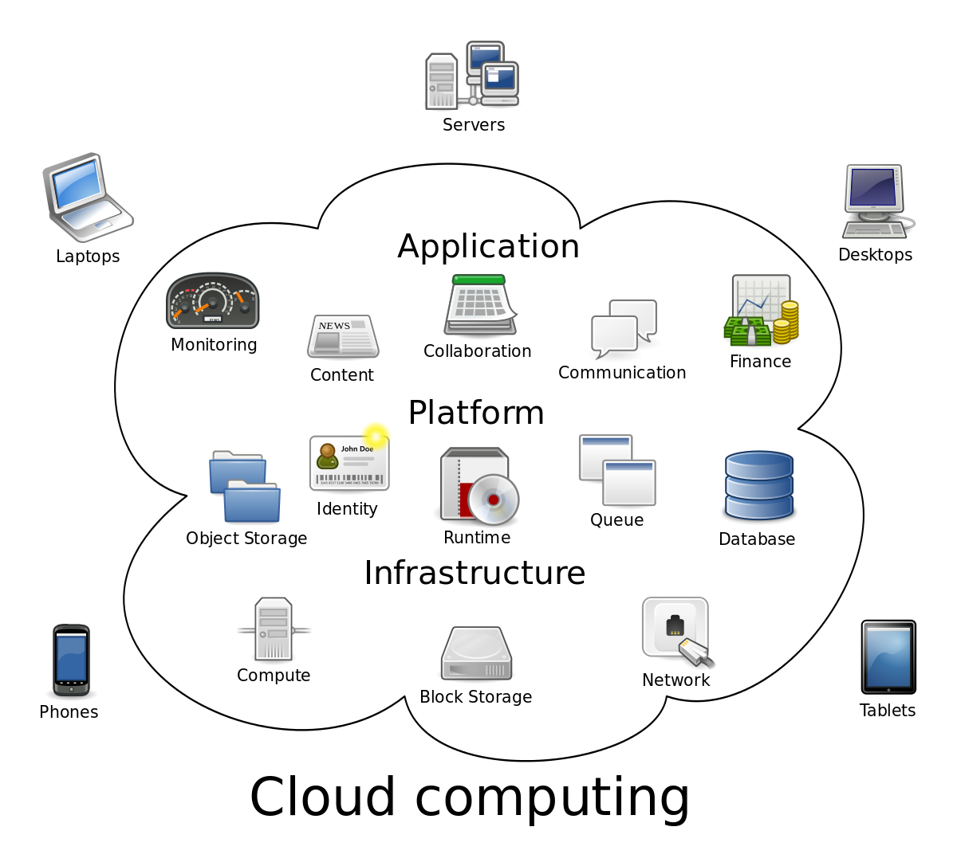
Cloud Computing
Cloud computing provides access to shared computing resources e-g servers, storage, networks, applications, services etc.
Features of cloud include:-
  On-demand self service
  Network access
  Resource pooling
  Elasticity
  Metered or measured service

Slide 4
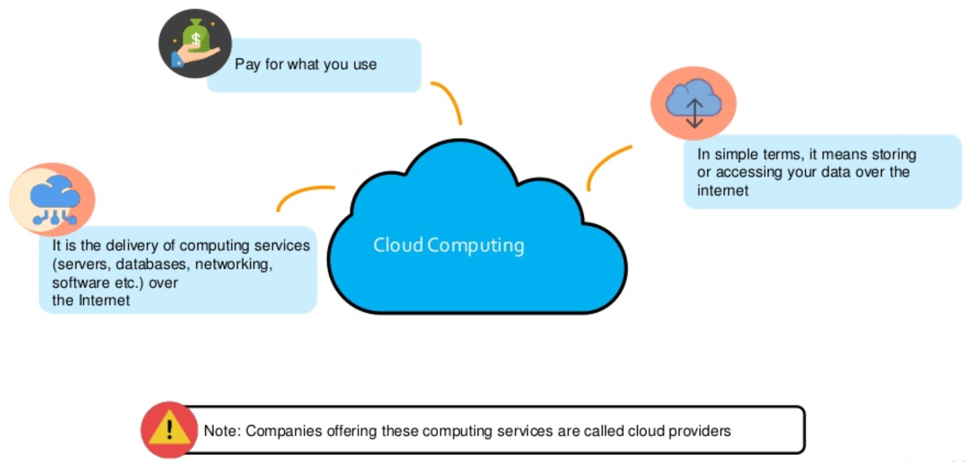
Cloud Computing

Slide 5
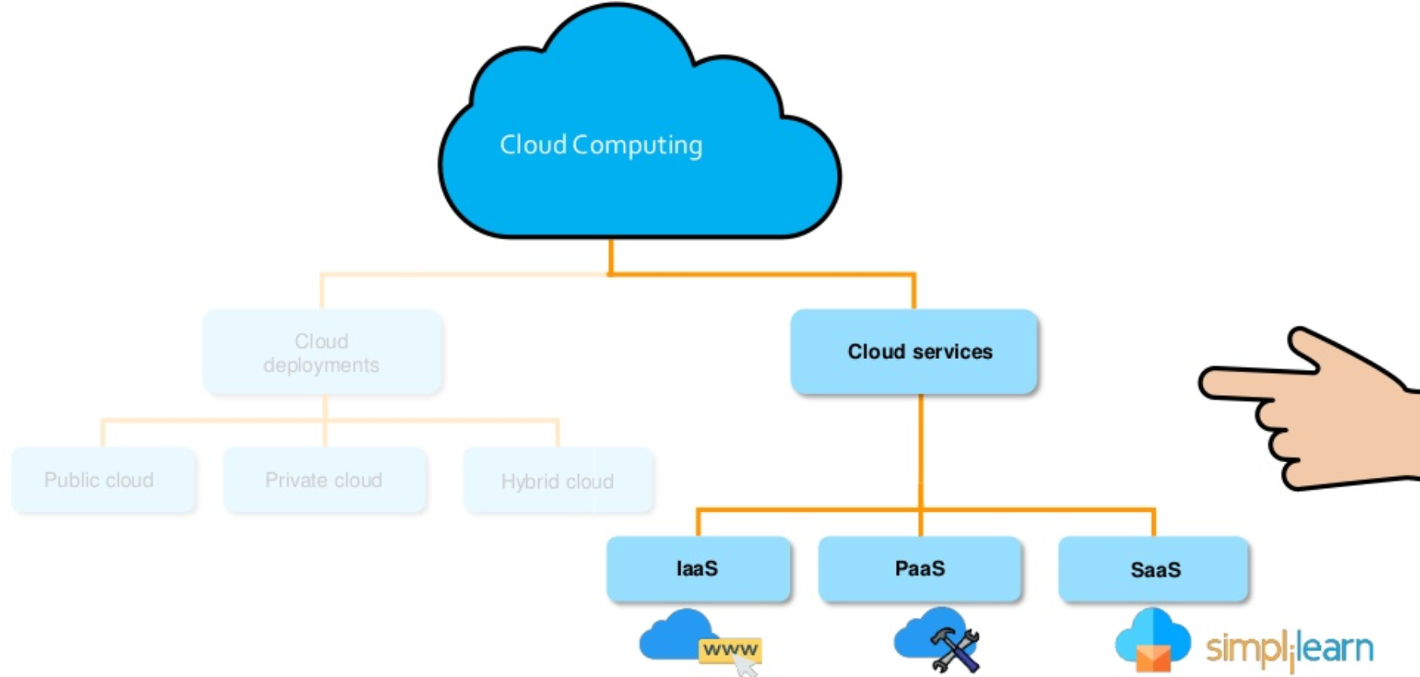

Slide 6
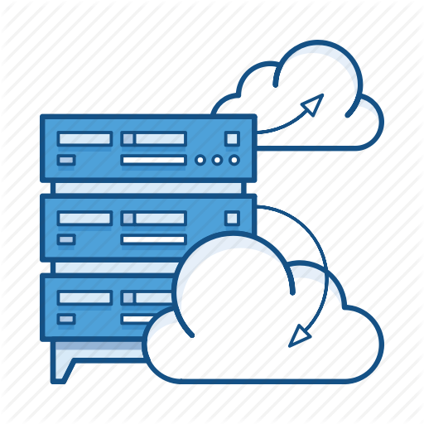
What Is IaaS

Slide 7
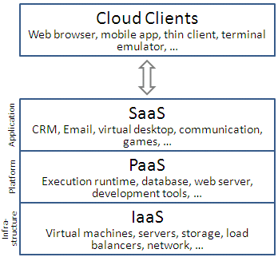
IaaS
Infrastructure as a Service is, where you have a hypervisor, you can provision virtual machines.
Infrastructure as a Service could also be where you're actually renting the physical server itself.
It's a couple of different definitions, but essentially it allows you to host an operating system on the cloud, which then is unique to you.
Nobody else can log into it, you go in and then manage it yourself.
So that's what Infrastructure as a Service is at a very high level.
So with Infrastructure as a Service you only pay for what you use, so it depends on the model.
On Amazon, it's a per second billing model right now for Linux instances.
Windows instances are on a per hour basis.
The idea is there's no long-term or fixed contract.
So if you need to stop using that service you can just power it down and you'll stop being billed for it.

Slide 8
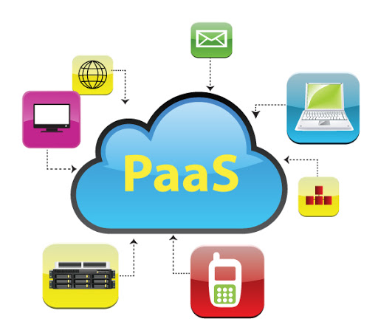
What Is PaaS

Slide 9
PaaS
Platform as a Service is basically something like Elastic Beanstalk.
This is where you don't necessarily know what resources you need but you've just got your code.
You will then use Platform as a Service to go in and provision those resources for you.
So Elastic Beanstalk will provision you, with elastic load balances, with EC2 instances, with databases etc.
So Platform as a Service, Azure was really strong in the Platform as a Service market, but Elastic Beanstalk came out with Amazon.
Google App Engine

Slide 10
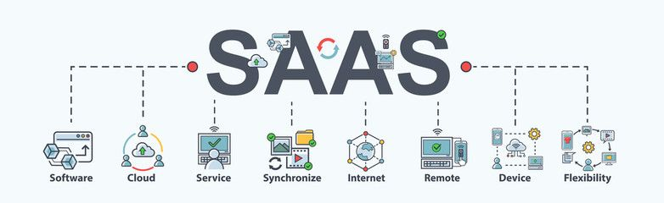
What Is SaaS

Slide 11
SaaS
Software as a Service is the easiest thing to understand, if you just think about something like Gmail.
With Gmail all you worry about is the actual software.
You worry about your inbox, you worry about spam filters, that sort of thing.
You're not worried about the underlying servers
That's Google's problem.
You don't have to worry about how they load balance it, how they provide high availability, how they do their DNS reading, all of that.
Software as a Service is where you just focus on the actual software itself.
Google Docs
Office 365

Slide 12
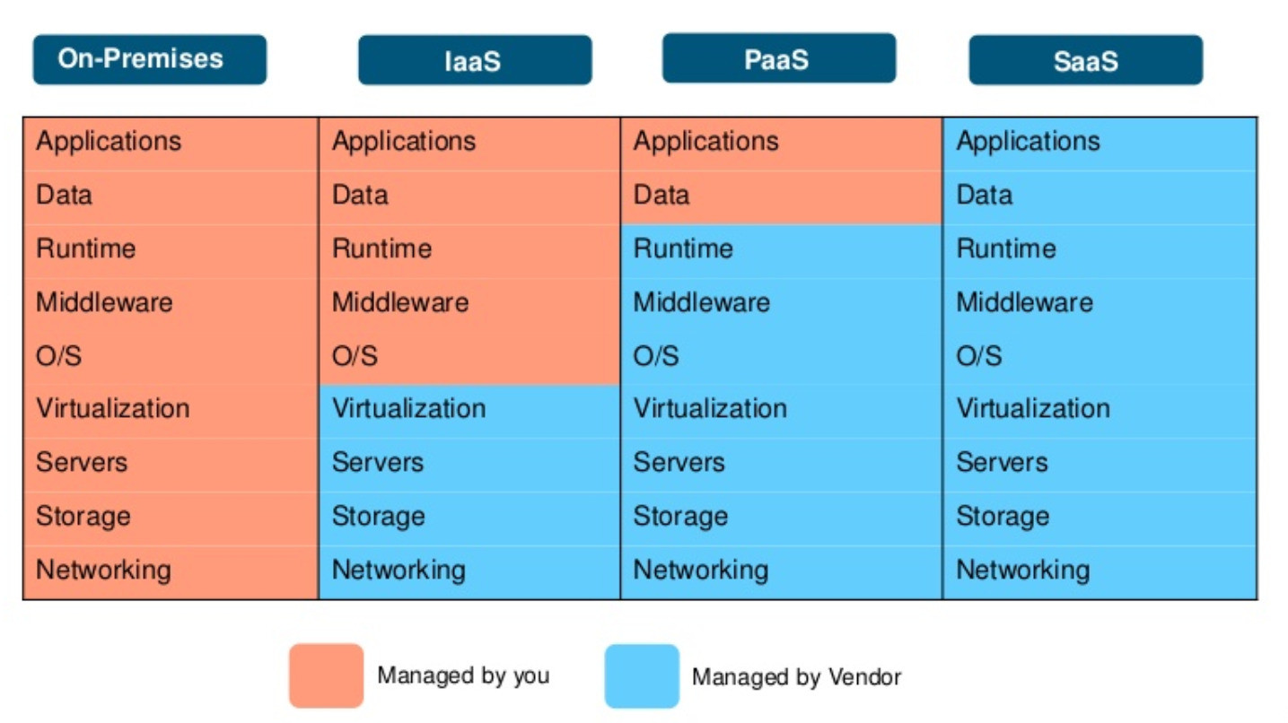
Difference b/w IaaS, PaaS & SaaS

Slide 13
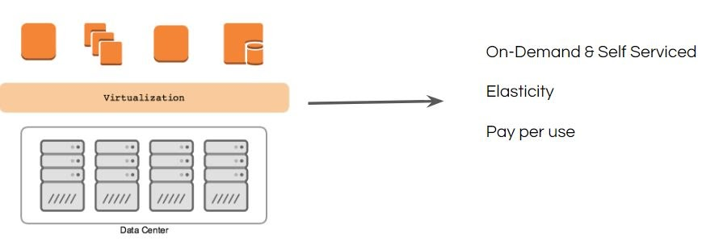
Architecture of Cloud Environments
The cloud from behind the scenes is the data center only.
Virtualization Technology plays a very important role in Cloud Computing.
Virtualization allows us to run multiple OS on a single hardware.
There are many virtualization software available like:
VMware Workstation / vSphere
KVM
XEN
VirtualBox

